Slide 1
Image Segmentation
Some slides: courtesy of O. Capms, Penn State,
J.Ponce and D. Fortsyth, Computer Vision Book

Slide 2
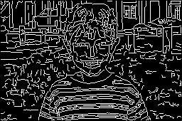
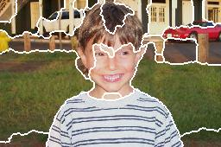
Regions and Edges
Ideally, regions are bounded by closed contours
We could “fill” closed contours to obtain regions
We could “trace” regions to obtain edges
Unfortunately, these procedures rarely produce satisfactory results.

Slide 3
Regions and Edges
Edges are found based on DIFFERENCES between values of adjacent pixels.
Regions are found based on SIMILARITIES between values of adjacent pixels.
Goal associate some higher level – more meaningful units with the regions of the image

Slide 4
Segmentation
Useful mid-level representation of an image - can facilitate better further tasks
Partitioning image into regions should be homogeneous with respect to some characteristic
(gray level, texture, color, motion)
The type of desired segmentation depends on the task
Broad theory is absent at present
Variety of approaches/algorithms
Applications finding people, summarizing video, annotation figures, background subtraction, finding buildings/rivers in satellite images

Slide 5
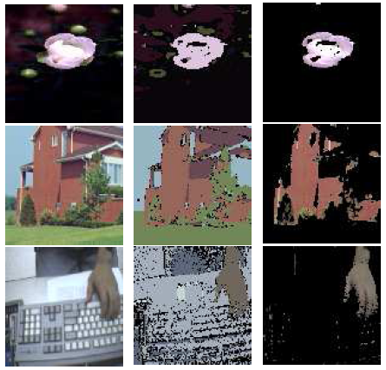
Segmentation and Grouping
Grouping (or clustering)
collect together tokens that “belong together”
Fitting
associate a model with tokens
issues
which model?
which token goes to which element?
how many elements in the model?

Slide 6
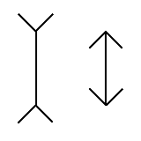
Grouping in humans
Figure-ground discrimination
grouping can be seen in terms of allocating some elements to a figure, some to ground
impoverished theory
Gestalt properties
elements in a collection of elements can have properties that result from relationships (Muller-Lyer effect)
Gestalt-qualitat
A series of factors affect whether elements should be grouped together
Gestalt factors

Slide 7
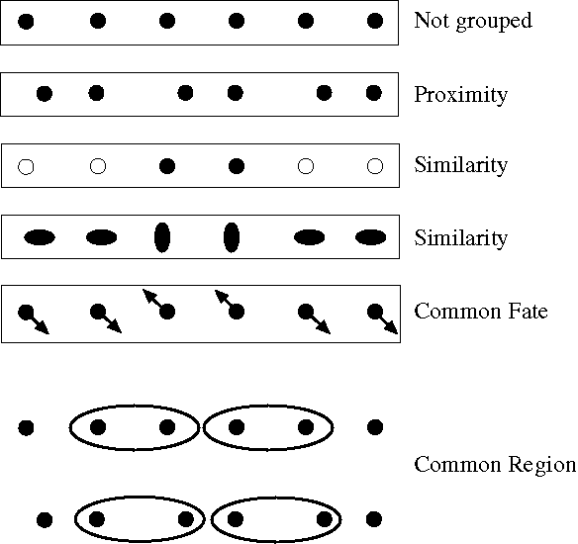
Notes:
Some criteria that tend to cause tokens to be grouped.

Slide 8
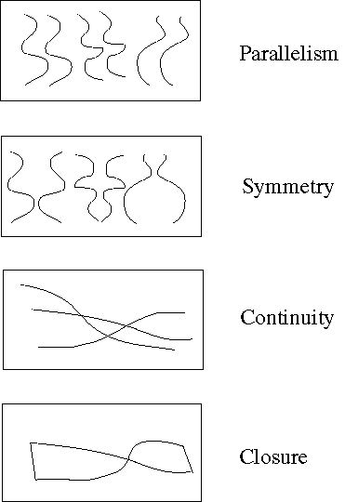
Notes:
More such

Slide 9
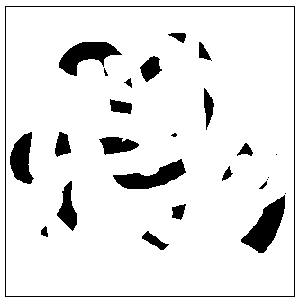
Notes:
Occlusion cues seem to be very important in grouping. Most people find it hard to read the 5 numerals in
this picture

Slide 10
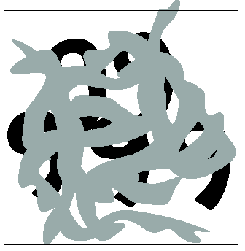
Notes:
but easy in this

Slide 11
Segmentation by Clustering
Pattern recognition
Process of partitioning a set of ‘patterns’ into clusters
Find subsets of points which are close together
Examples
Cluster pixels based on intensity values
Color properties
Motion/optical flow properties
Texture measurements etc.
Input – set of measurements x1, x2, …, xm
Output – set of clusters and their centers

Slide 12
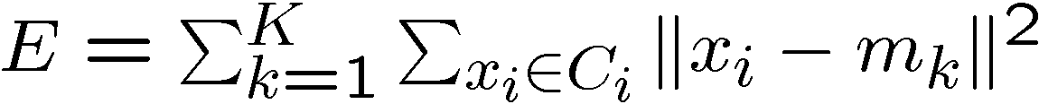
Clustering
Find set of clusters such that the least squares
Error is minimized
Iterative K-means clustering algorithm
set iter = 1;
Choose randomly K-means m1, … mk
For each data point xi, compute distance
to each of the means and assign the point
the cluster with the nearest mean
4. iter = iter + 1
5. Recompute the means based on the new assignments
of points to clusters
6. Repeat 3-5 until the cluster centers do not change much

Slide 13
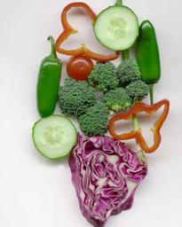
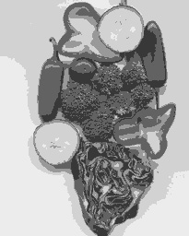
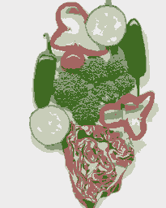
Image
Clusters on intensity
Clusters on color
K-means clustering using intensity alone and color alone
Notes:
I gave each pixel the mean intensity or mean color of its cluster --- this is basically just vector quantizing the image intensities/colors. Notice that there is no requirement that clusters be spatially localized and they’re not.

Slide 14
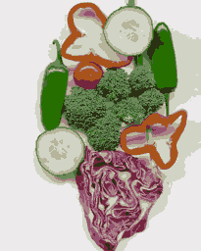
Image
Clusters on color
K-means using color alone, 11 segments

Slide 15


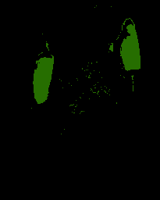

K-means using
color alone,
11 segments.

Slide 16

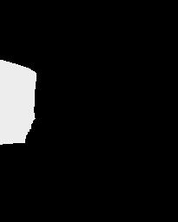



K-means using colour and
position, 20 segments
Notes:
Here I’ve represented each pixel as (r, g, b, x, y), which means that segments prefer to be spatially coherent. THese are just some of 20 segments.

Slide 17
Segmentation with EM
There are n – pixels and g groups – compute how likely is a pixel belonging to group and also what are the parameters of the group
Probabilistic K-means clustering
E.g. Use of texture and color cues

Slide 18
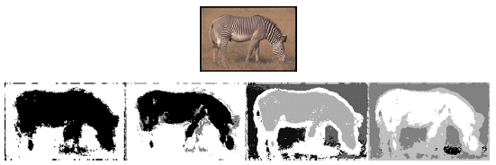
Segmentation with EM
Figure from “Color and Texture Based Image Segmentation Using EM and Its Application to Content Based Image Retrieval”,S.J. Belongie et al., Proc. Int. Conf. Computer Vision, 1998, c1998, IEEE
Notes:
This is figure 16.2 - story in the caption

Slide 19
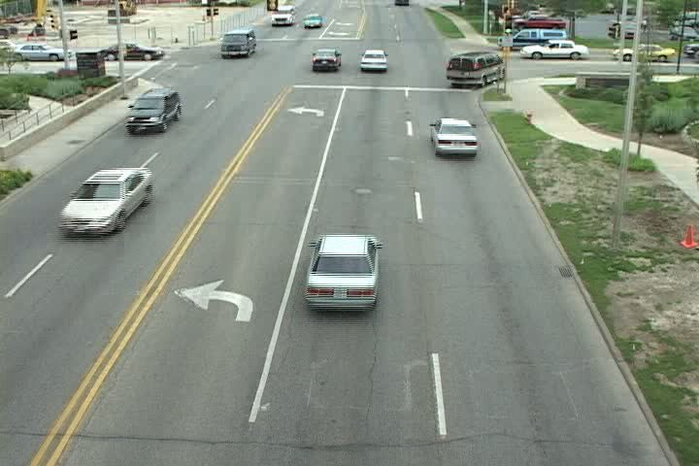
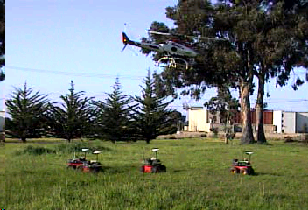
Motion Segmentation
Given a set of image points obtain:
Number of independently moving objects
Segmentation: object to which each point belongs
Motion: rotation and translation of each object
Structure: depth of each point

Slide 20
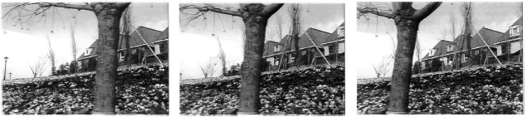
Motion Segmentation Problem
Three frames from the MPEG “flower garden” sequence
Given optical flow at each point
partition/segment the flow field into regions belonging to
individual planes “layers”
Figure from “Representing Images with layers,”, by J. Wang and E.H. Adelson, IEEE Transactions on Image Processing, 1994, c 1994, IEEE
Some example slides from Forsythe and Ponce. Computer Vision, A modern approach.
Notes:
Story in figure 16.5

Slide 21
Model Estimation and Grouping
Given a set of data points and a particular model
The model parameters can be estimated by LSE
fitting data to the model
Previous model examples – essential/fundamental matrix, homographies, lines/planes
In order to estimate the model parameters we need to
know which data point belongs to which model
Difficulty – we have multiple models – we do not know initially which data point belongs to which model and we do not the model parameters
chicken and egg problem

Slide 22
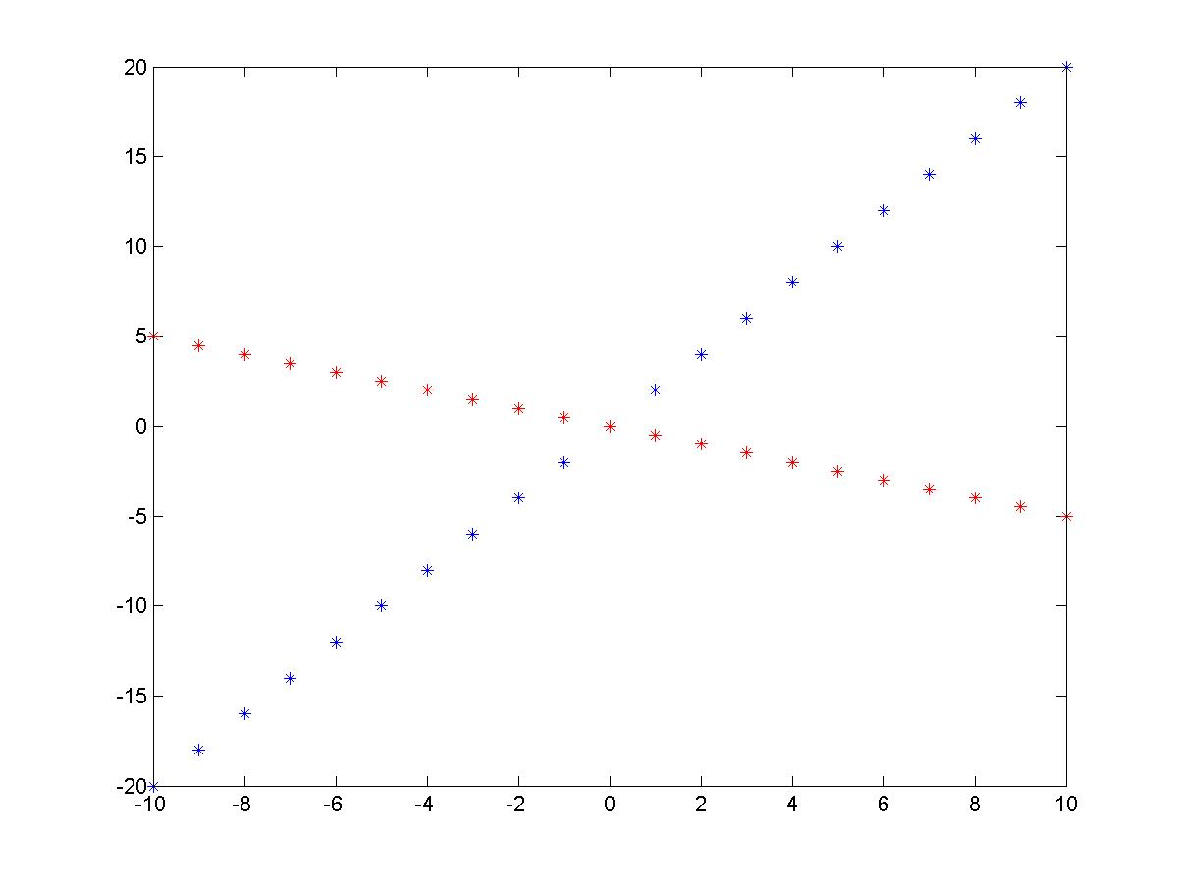
Model Estimation and Grouping
Line Example
Set of points belonging to two lines
We need to estimate
1. parameters of the lines
slope and intercept
2. which point belongs to
which line
Solution: EM algorithm
Idea: Each of the above steps
Assumes the other one is
solved and iterate

Slide 23
EM algorithm
Basic structure of the EM algorithm
1. Start with random parameter values for each model
2. Iterate until parameter values converge
E step: assign points to the model that fits best
M step : update the parameters of the models using
only points assigned to it
Simplistic explanation here –
Theoretical foundation probabilistic (model parameters
are random variables) - EM (Expectation Maximization)

Slide 24

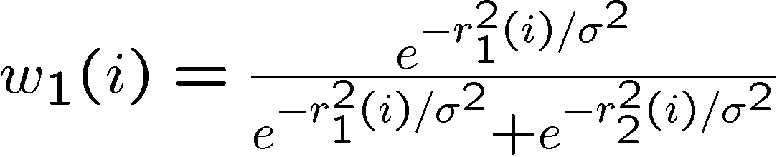

E- Step
Case of two lines given by slopes and intercepts
For each data point i, estimate the residual
(difference between the prediction and the model)
Calculate the weights, which correspond to the probabilities of particular data point belonging to particular model

Slide 25
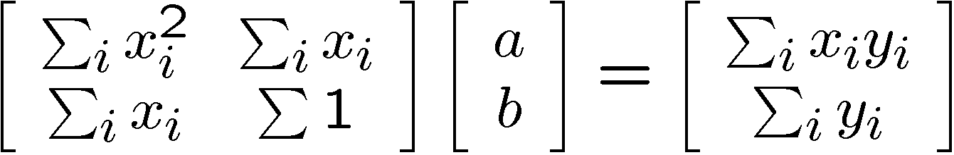
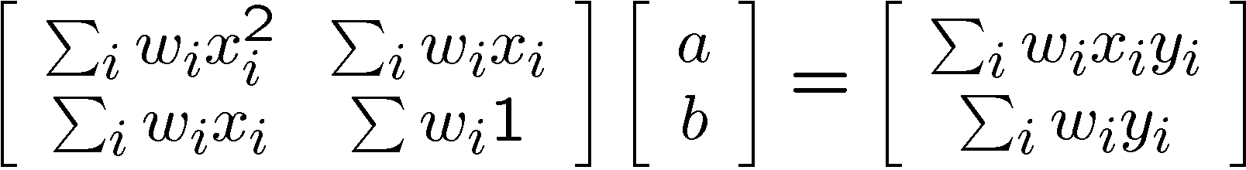
M-step
Given the weights recalculate the parameters of the model
Least squares estimation of line parameters
In our case we will have weighted least squares estimation of line parameters
Solve such estimation problem twice – once for each line

Slide 26
M-step
Iterate until the parameters of the
Lines converge
Issues with EM
Local maxima
can be a serious nuisance in some problems
no guarantee that we have reached the “right” maximum
Starting if we do not know how many models we
have
k means to cluster the points is often a good idea

Slide 27



Example: motion segmentation
Consider motion model, when the flow field
can be approximated by some parametric model
with small number of parameters
We can write x and y parameters of the flow field –
assume that models are locally translational, i.e.
we can locally approximate the model by pure translation
Suppose entire flow field can be explained by
two translational models
EM algorithm can be applied in analogous way

Slide 28
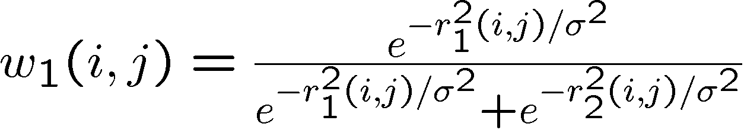
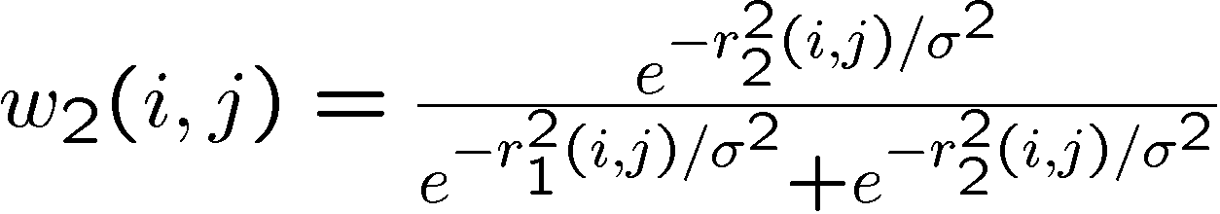
Example: motion segmentation
Compute residuals
Compute associated weights
M-step analogous to line fitting
Iterate until convergence

Slide 29
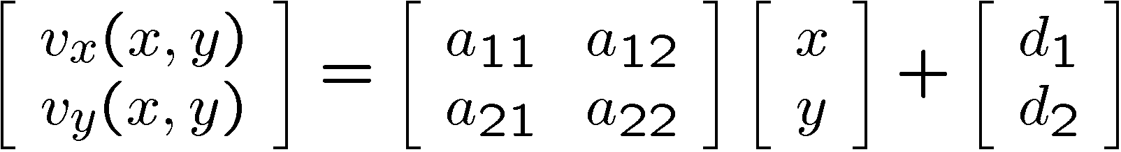
Example: motion segmentation
Model image pair (or video sequence) as consisting of regions of parametric motion
affine motion – commonly used –
Approximates locally motion of the planar surface
Now we need to
determine which pixels belong to which region
estimate parameters

Slide 30
Three frames from the MPEG “flower garden” sequence
Figure from “Representing Images with layers,”, by J. Wang and E.H. Adelson, IEEE Transactions on Image Processing, 1994, c 1994, IEEE
Notes:
Story in figure 16.5

Slide 31
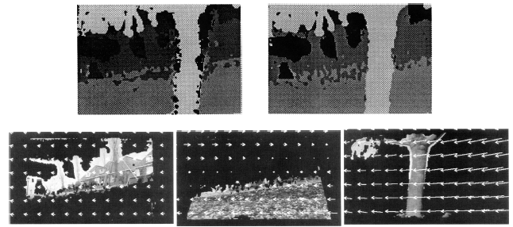
Grey level shows region no. with highest probability
Segments and motion fields associated with them
Figure from “Representing Images with layers,”, by J. Wang and E.H. Adelson, IEEE Transactions on Image Processing, 1994, c 1994, IEEE
Notes:
Figure 16.6

Slide 32
Other examples
Segmentation
a segment is a gaussian that emits feature vectors (which could contain color; or color and position; or color, texture and position).
segment parameters are mean and (perhaps) covariance
if we knew which segment each point belonged to, estimating these parameters would be easy

Slide 33
Some generalities
Many, but not all problems that can be attacked with EM can also be attacked with RANSAC
need to be able to get a parameter estimate with a manageably small number of random choices.
RANSAC is usually better
We wish to choose a model to fit to data
e.g. is it a line or a circle?
e.g is this a perspective or orthographic camera?
e.g. is there an airoplane there or is it noise?
In general, models with more parameters will fit a dataset better, but are poorer at prediction

Slide 34
Segmentation as Graph Partitioning
(Shi & Malik ‘’97)
Idea – each pixel in the image is a node in the graph
Arcs represent similarities between adjacent pixels
Goal – partition the graph into a sets of vertices
(regions), such that the similarity within the region
is high – and similarity across the regions is low.
- See textbook for detailed description the algorithm.

Slide 35
Segmentation

Slide 36
Graph theoretic clustering
Represent tokens using a weighted graph.
affinity matrix
Cut up this graph to get subgraphs with strong interior links

Slide 37
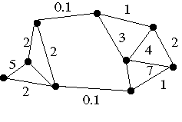


Slide 38
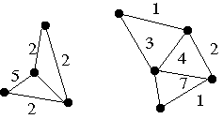

Slide 39
Measuring Affinity
Intensity
Distance
Texture
Notes:
here c(x) is a vector of filter outputs. A natural thing to do is to square the outputs of a range of different filters at different scales and orientations, smooth the result, and rack these into a vector.

Slide 40
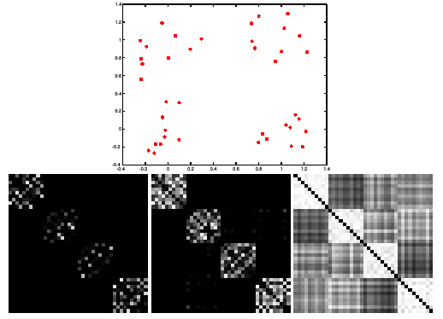
Scale affects affinity
Notes:
This is figure 14.18

Slide 41
Eigenvectors and cuts
Simplest idea: we want a vector giving the association between each element and a cluster
We want elements within this cluster to, on the whole, have strong affinity with one another
We could maximize
But need the constraint
This is an eigenvalue problem - choose the eigenvector of A with largest eigenvalue - single good cluster

Slide 42
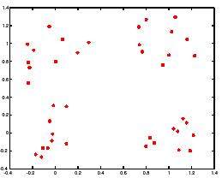
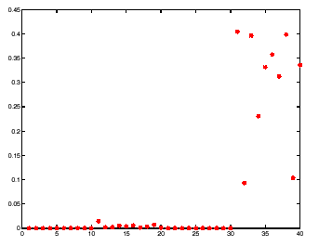
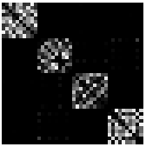
Example eigenvector
points
eigenvector
matrix

Slide 43
More than two segments
Reasoning about other eigenvectors - consider that affinity matrix is block diagonal.
Until there are sufficient clusters pick eigenvector associated with the largest eigenvalue, zero the elements which were clustered, threshold elements with large association weights - those will form a new cluster
Keep going until there is sufficient number of clusters and all elements have been accounted for
Spectral Clustering Techniques (A. Ng and M. Jordan)
Problems - if the eigenvalues are similar - eigenvectors do not reveal the clusters
Normalized cut - graph cut - alternative optimization criterion J. Shi and J. Malik

Slide 44
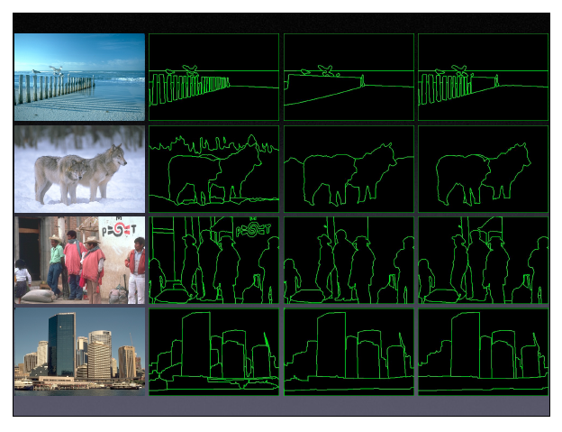

Slide 46
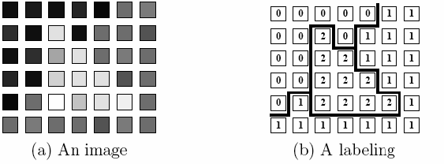

Graph Cuts, MRF’s
Pixel labeling problem - find such labels that the
objective function is minimized
labels (stereo, object/no-object, original intensities
(denoising)

Slide 47
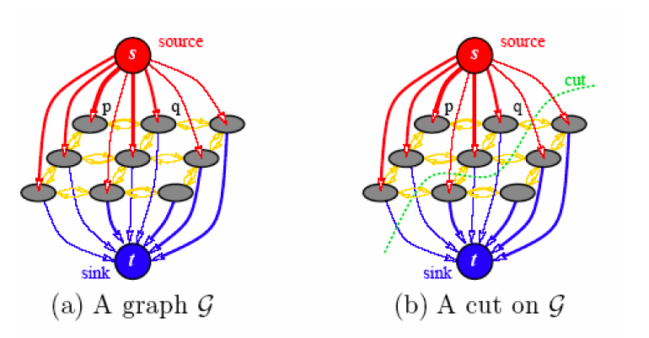
Graph Cut
Formulated as minimum cost flow -
Network flow problem from Graph Theory
Kolmogorov, Boykov (et al)
efficient solvers available

Slide 48
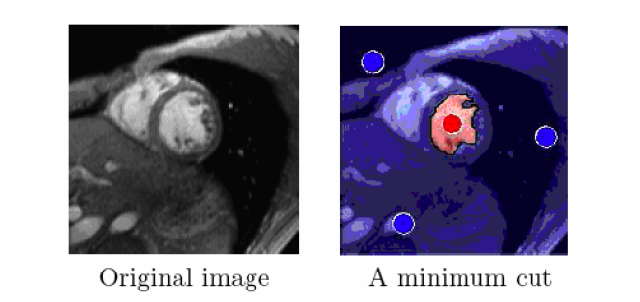
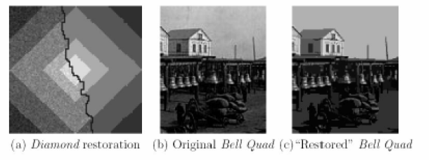
Graph Cut

Slide 49
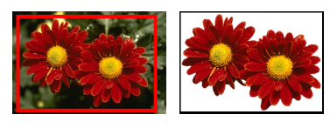
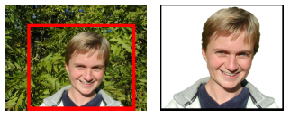
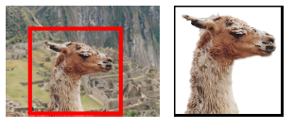
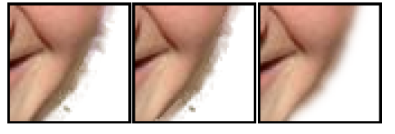
Interactive Foreground Segmentation
Interaction Foreground Segmentation: Grab Cuts
Rother, Kolmogorov, Blake, SIGRAPH 2005

Slide 50
Motion Segmentation cont.
Given a set of image points obtain:
Number of independently moving objects
Segmentation: object to which each point belongs
Motion: rotation and translation of each object
Structure: depth of each point

Slide 51
Alternative Algebraic approach
Generalized principal component analysis
Main idea:
Automatic determination of the number of models
Model parameter estimation, via polynomial factorization

Slide 52



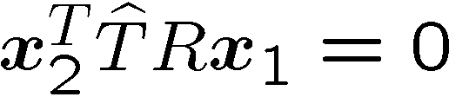





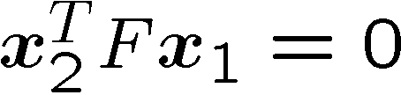
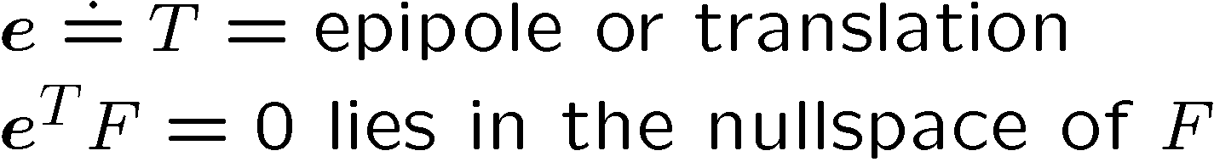

Single Motion Epipolar Constraint

Slide 53

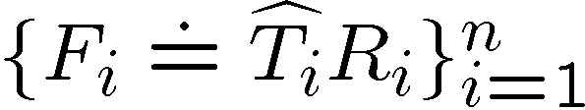
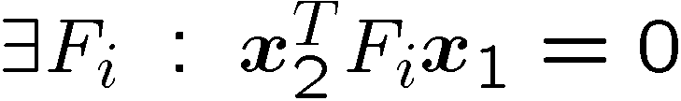


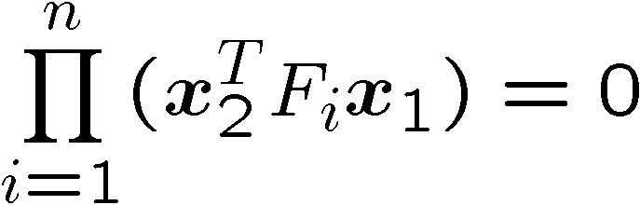
Multibody Epipolar Constraint

Slide 54
Decomposition of Multibody F
n motions generate n groups of epipolar lines
Each group will intersect at the epipole e_{i}
Details Chapter 7

